Slide 1

TONY KIMATHI
C026-01-0713/2020
BSC COMPUTER SCIENCE 4TH YEAR
Wi-Fi: How It Changed Our World
From a Small Idea to Connecting Everyone

Slide 2
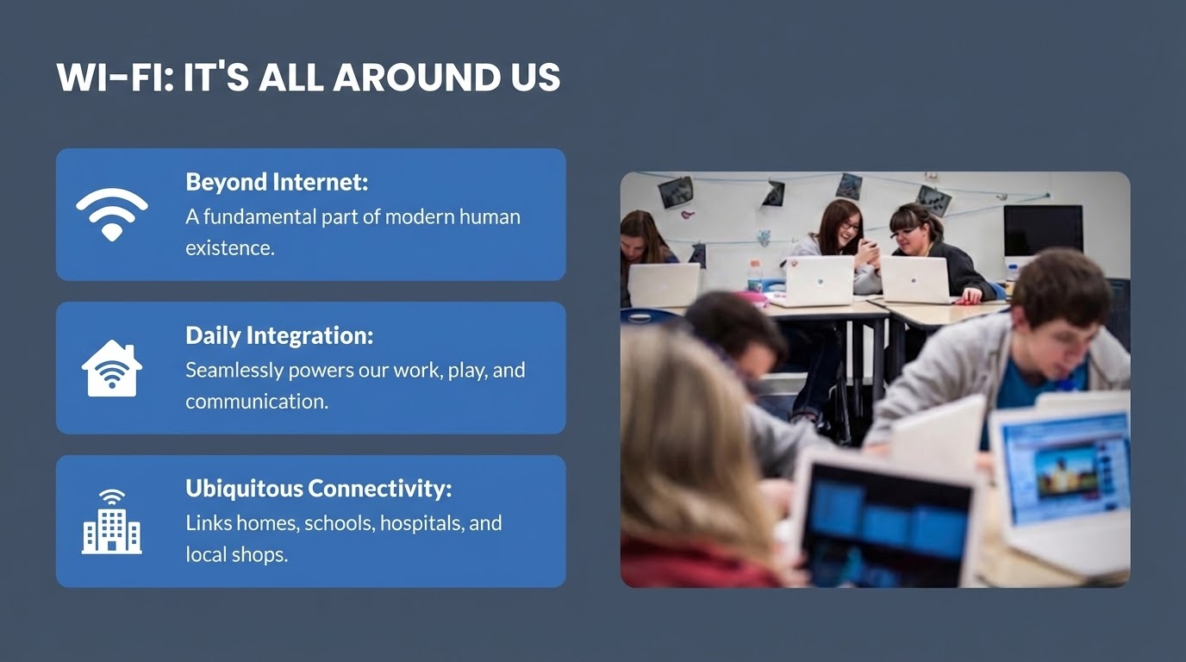

Slide 3


THE FIRST STEPS
Early concepts of transmitting data without physical wires.
Born from brilliant minds and critical military research.
Built upon numerous experimental wireless attempts.

Slide 4


THE WI-FI RULEBOOK
IEEE 802.11 Standards
The IEEE established the universal "rules" for wireless communication, ensuring that devices from different manufacturers could finally "talk" to each other.
This standardization was the single most important factor in Wi-Fi's global success and popularity.

Slide 5

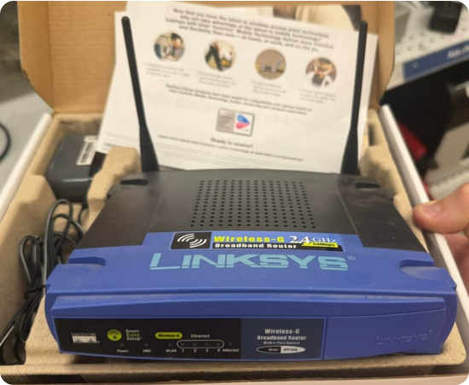
MAKING IT EASY: THE "WI-FI" BRAND
Wi-Fi Alliance: Founded in 1999 to certify wireless products.
The Name: Coined the catchy term "Wi-Fi" to replace technical jargon.
Interoperability: Guaranteed a smooth experience for users worldwide.

Slide 6
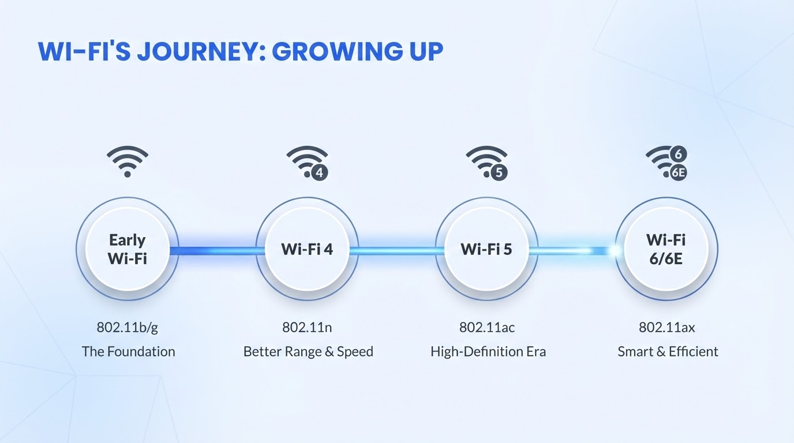

Slide 7







HOW WI-FI CHANGED EVERYTHING
Work & Learn
Smart Tech
Accessibility
Enabling freedom to study in parks or work remotely from any corner of the globe.
Powers IoT ecosystems, from robot vacuums to smart city sensors.
Connecting underserved communities to the world's knowledge base.

Slide 8
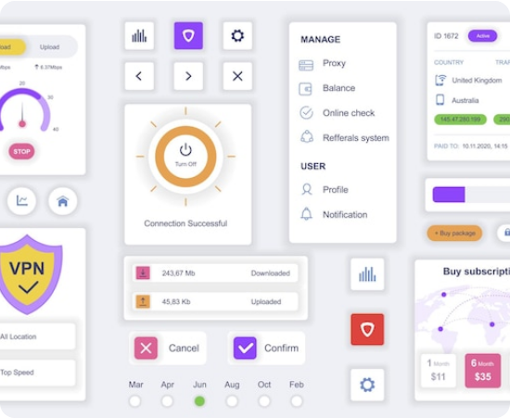
MY PROJECT: ROUTER ADMIN ACCESS
Network Monitor: A tool built to identify and verify devices on a local network.
Diagnostic Power: Inspired by apps like Wi-Fi Man and Fing.
Security Focus: Developed to understand network security and unauthorized access prevention.

Slide 9


The Future: Wi-Fi 7 and Beyond
We are entering an era of ultra-low latency and multi-gigabit speeds. Wi-Fi will soon power fully immersive virtual realities and super-connected smart cities with zero delays.

Slide 10





LOOKING AHEAD: PROBLEMS AND CHANCES
Challenges
Opportunities
Maintaining security, managing signal interference, and protecting user privacy in a crowded digital space.
Boosting global economies, enabling precision agriculture, and connecting the remaining 3 billion people.

Slide 11
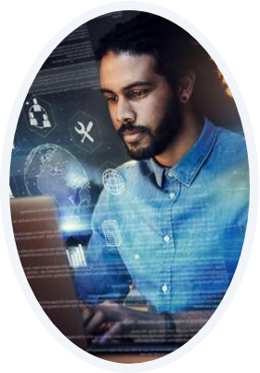
BUILDING A CONNECTED FUTURE
My Goal as a Cloud Engineer
I am committed to designing and deploying the robust, secure, and scalable cloud infrastructures that will support the next generation of Wi-Fi technology.
Connectivity is more than just data—it's a bridge to opportunity and a better quality of life for all.

Slide 12



Asante Sana!
Thank you very much for your time.
Questions?
tonykimathi8121@gmail.com

